Slide 1

Establishing an inclusive and sustainable design program for assistive technology
Joe Lawler, Alyssa Spomer, Keshia Peters, Katherine Steele
CSNE Research Symposium 2018
Ability & Innovation Lab, Mechanical Engineering, University of Washington, Seattle, WA USA
Notes:
CSNE researchers work to tackle technical problems on a large scale, HuskyADAPT works to find individualized solutions for accessibility problems in our community. My project this summer focused on how to preserve and push forward the work done by HuskyADAPT

Slide 2
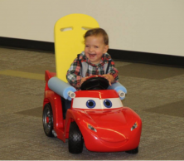
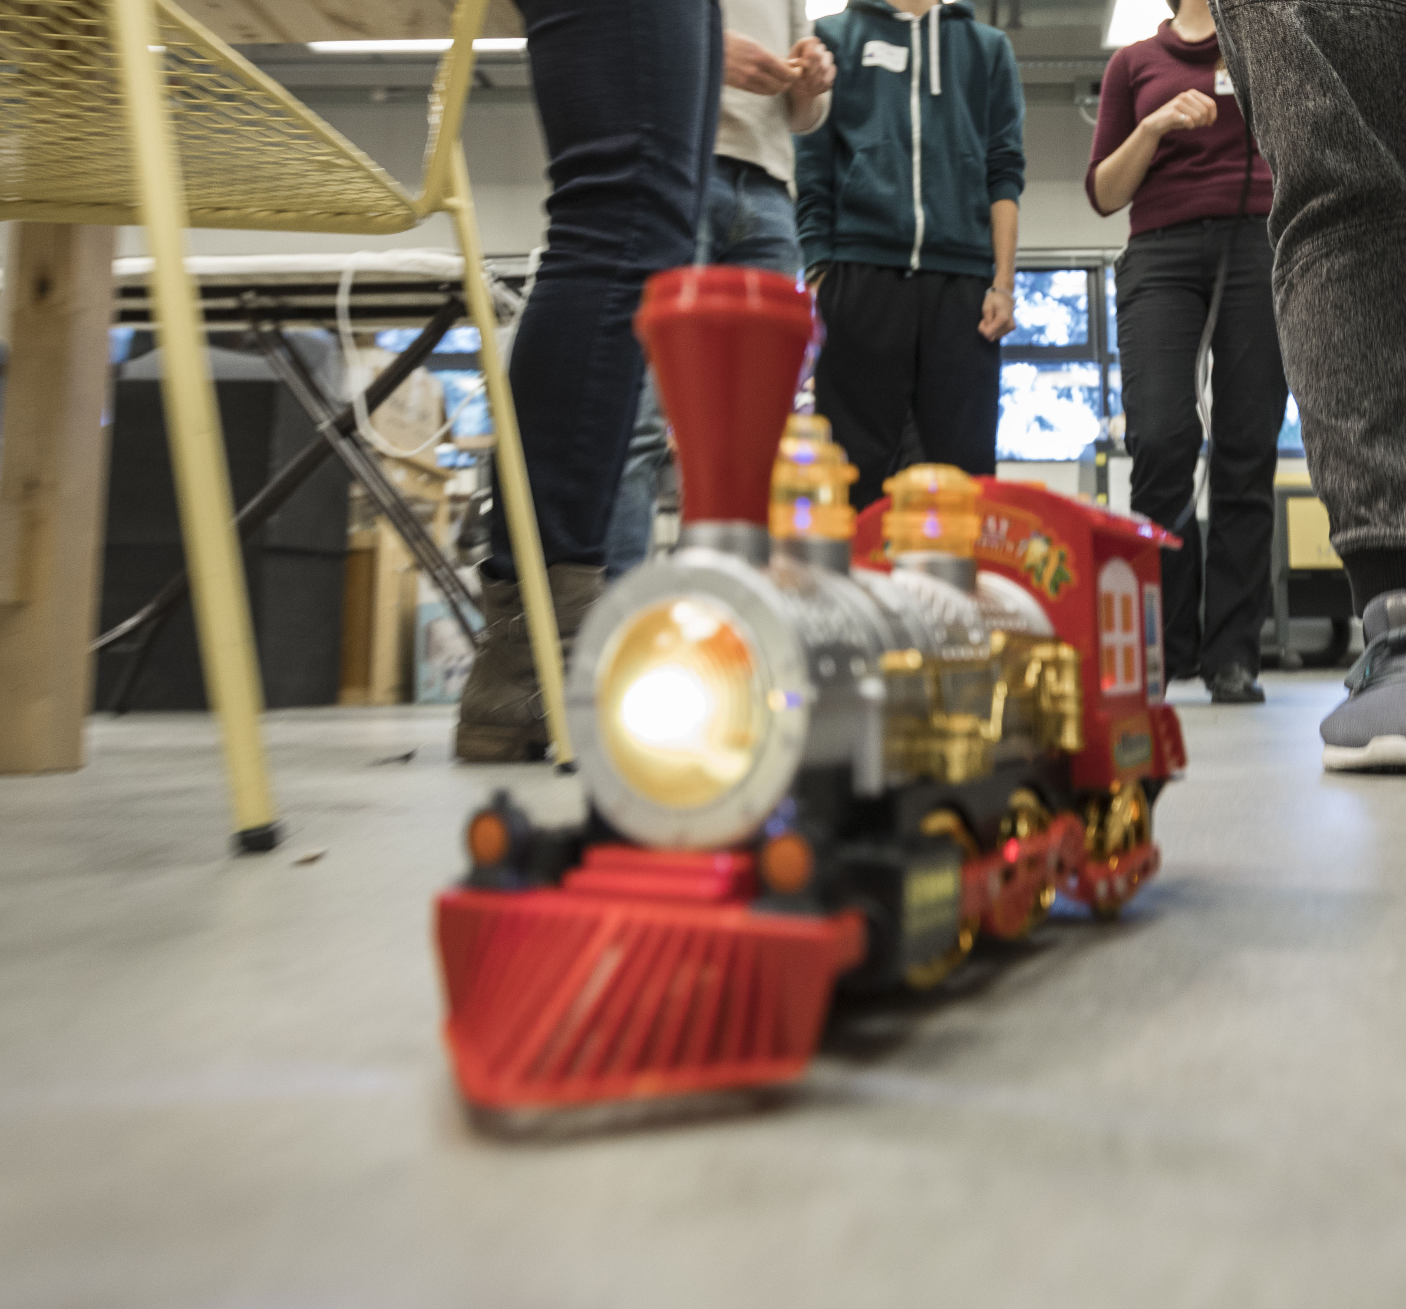
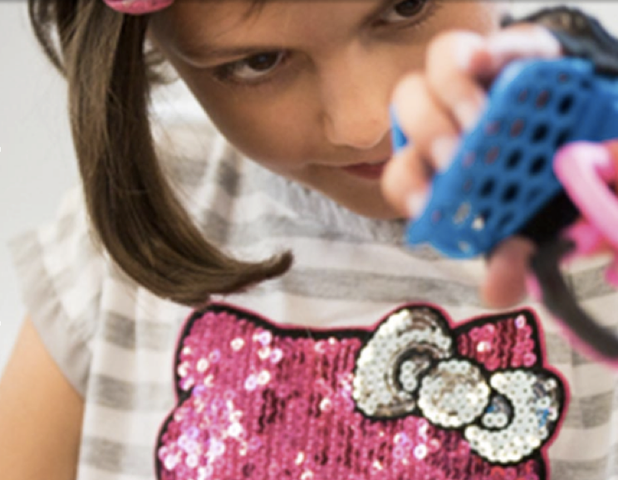
What is HuskyADAPT?
Go Baby Go
Toy Adaptation
Design
Incorporated accessibility features
Taught X amount of people how to modify cars
Modified X amount of cars
Enable all children to engage with toys
Adapted 224 toys
Taught 348 people toy adaptation
Created 19 design teams
Presented work at multiple research symposiums
Notes:
What I’ll say:
Go Baby Go –Host workshops to modify battery powered ride on cars for children with varying abilities, provide children with independence
Toy Adaptation –Teach community members to adapt toys. This enables children to engage with toys in ways previously inaccessible to them and gain the developmental benefits

Slide 3
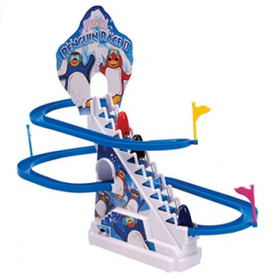
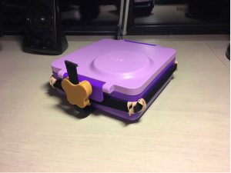
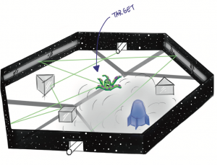
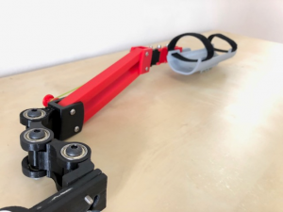
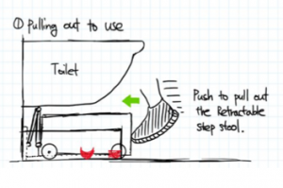
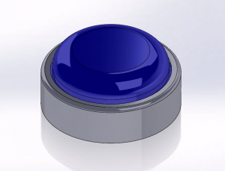
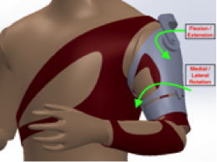
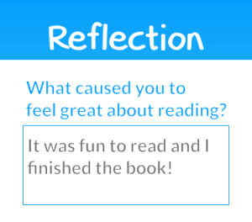
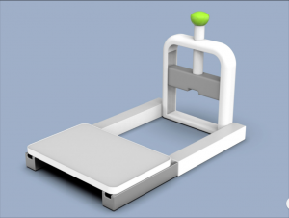
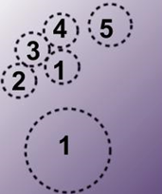
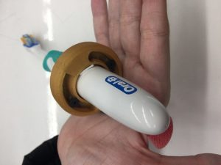
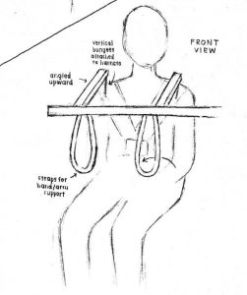
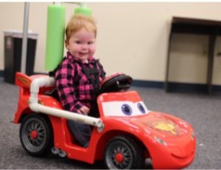
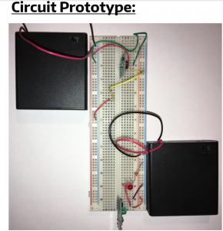
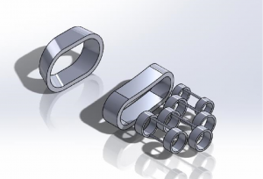
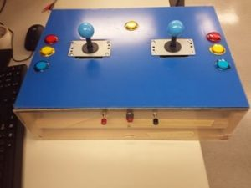
Design Projects
Notes:
19 design projects last year, talk briefly about mine, clearly this club is already successful so the question is…

Slide 4
How can we preserve and further this work?
Aim
1
Develop an online database storing all documentation from design projects enabling others to explore, download and iterate upon our work
Aim
Develop an optimized and replicable process for creating the design challenges for upcoming years
2
(ALT question) How can we make HuskyADAPT a sustainable program?
Notes:
Transition:
Mentioned design projects, design challenges, what does that look like?
Or
As an example of how others someone could iterate upon our work, I pushed forward a design project

Slide 5
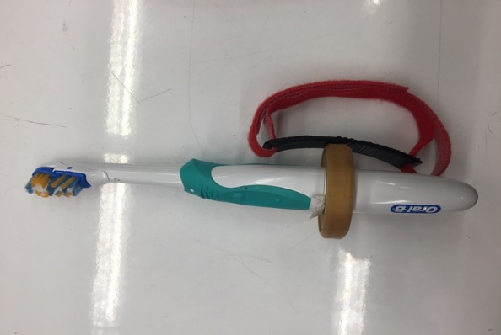
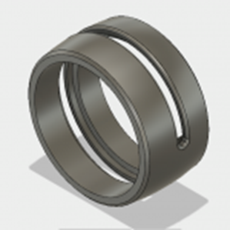
Furthering a Design Project
How can we help individuals with limited hand function perform daily hygienic tasks?
Built upon the work performed by Team Cajun
Created a modular tool that enables user to effectively manipulate a variety of objects
Rotates toothbrush to users needs
360 degrees laterally
270 degrees axially
Notes:
Introduce design challenge, what was done before, I wanted to design something specifically for Erin Ciliv

Slide 6
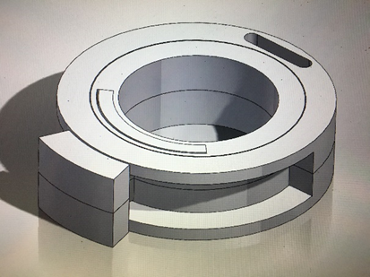
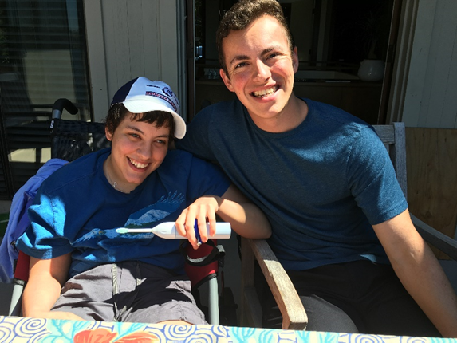
Furthering a Design Project
Designed a tool specifically for need expert Erin Ciliv
A need expert is a community member who provides invaluable insight on a particular disability
Iterated through multiple prototypes based off of user feedback
Device builds upon Erin’s ability with her left hand
Rotates 180 degrees
Future
Implement attachment to act as a button
Modify toothbrush stand
Notes:
Capitalizes on Erin's flexion in her wrist

Slide 7
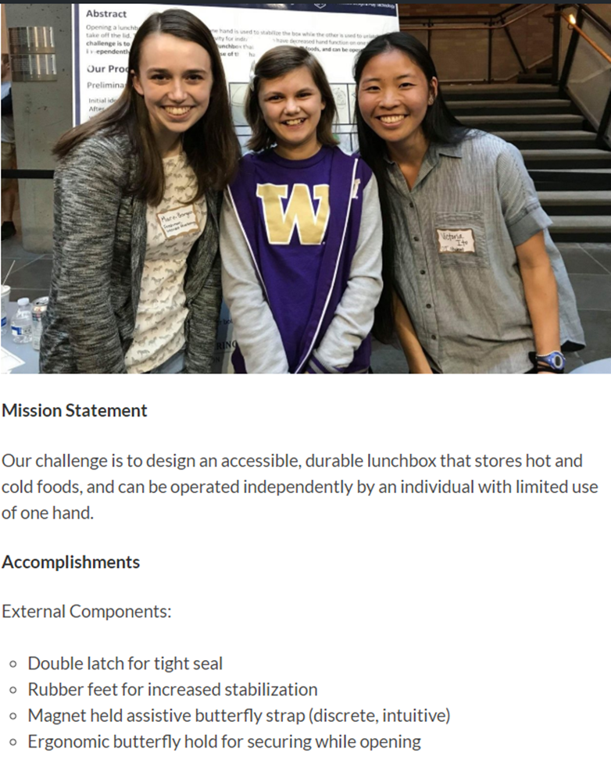
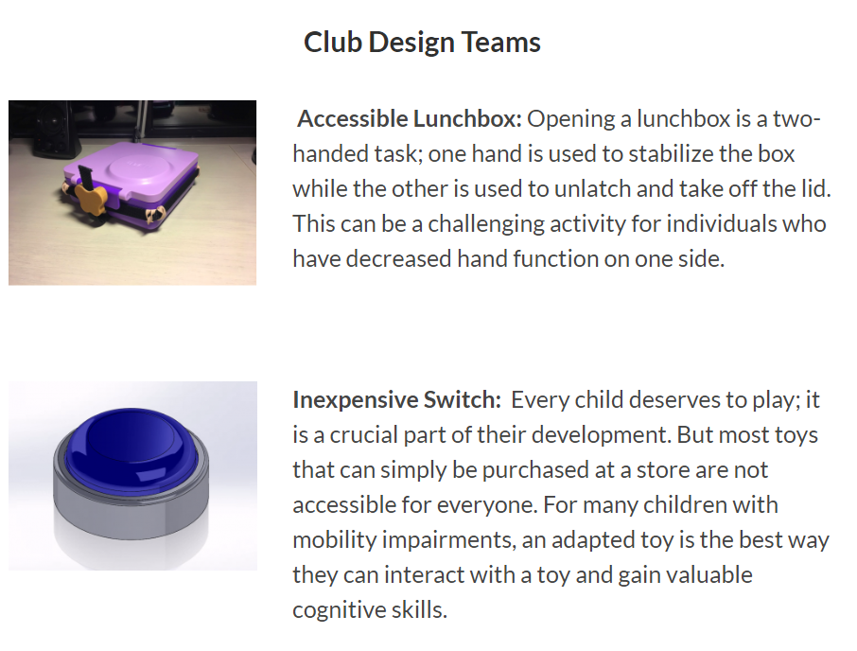
Design Projects 2017-2018
Created a website showcasing all past and ongoing projects
Ensures others may explore and iterate upon our work
Incorporated accessibility features
Alternative text, screen reader compatible
Notes:
Organized in an online repository, central page showcasing all 19 design challenges, each branches off to a team page…
Site is accessible

Slide 8
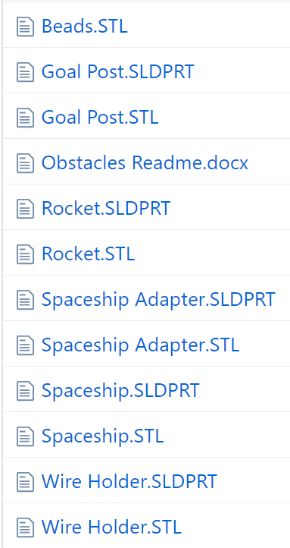
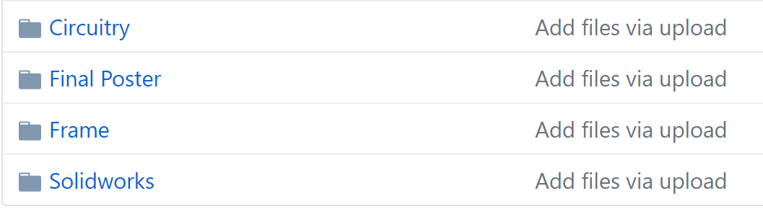
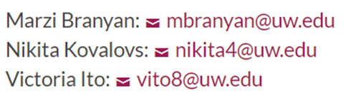
Design Projects 2017-2018
Each design team has their own page
Mission statement, accomplishments, next steps, contact information and files
Provides access to Github repository of documentation
Community can get a first hand look at the design process
Able to utilize our designs by downloading CAD files
Notes:
Content of team pages, why we included the information we did, etc

Slide 9
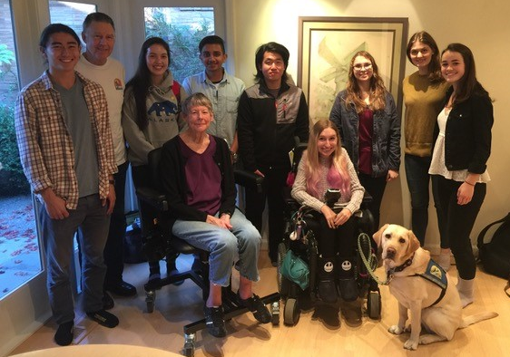
Design Projects 2018-2019
Facilitate the creation of the design projects for next year
Modified survey sent out to need experts
Centralized repository of community members contact information
Created an interview document for meetings with need experts
Future
One page summary of each design challenge
Notes:
Too much text before so am just going to say the subpoints out loud
Systematic approach to be replicated in future years
Sets expectations for need experts and teams
Incorporated feedback from experts in the field
Formatted to ensure most valuable information is gathered

Slide 10
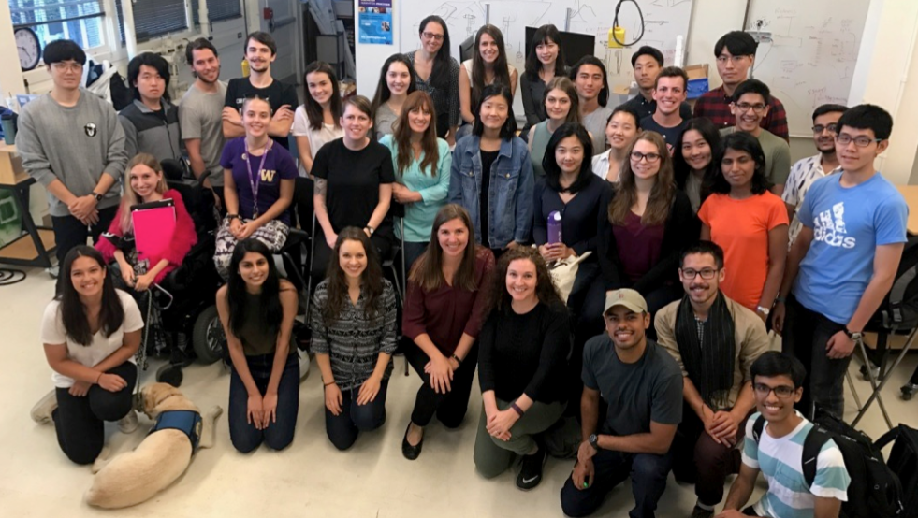
Future of HuskyADAPT
Notes:
In addition to introducing engineers to new ways of approaching design and creating a wide variety of accessible design, HuskyADAPT also helps foster incredible relationships. I personally was lucky enough to meet Erin, the need expert who I talked about earlier. Her and I facetime nearly every day and she's the kind of person you call and always feel better after talking to her. She’s had an immense impact on my life and I know I have found a lifelong friend. This is just another reason why the work we do is so important and needs to be preserved and pushed forward. Thank you.

Slide 11



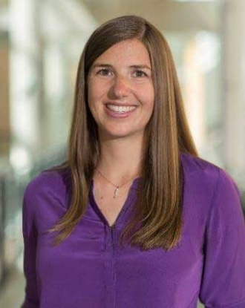
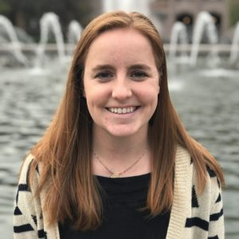
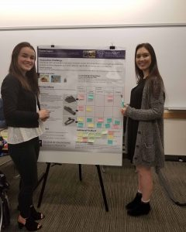
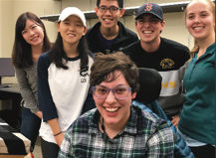
Acknowledgements
University of Washington, Ability and Innovations lab
Team Cajun
Keshia Peters
Alyssa Spomer
Kat Steele, PhD
Need Expert
Erin Ciliv

Slide 12
Thank you!
Questions?

